Slide 1
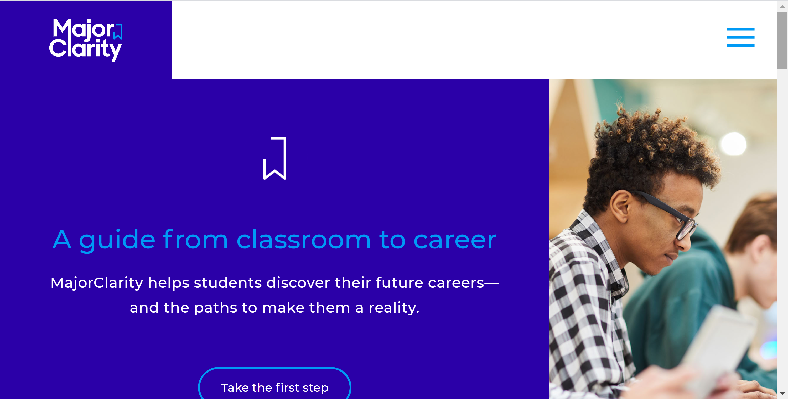
Major Clarity.com

Slide 2
Major Clarity.com

Slide 3
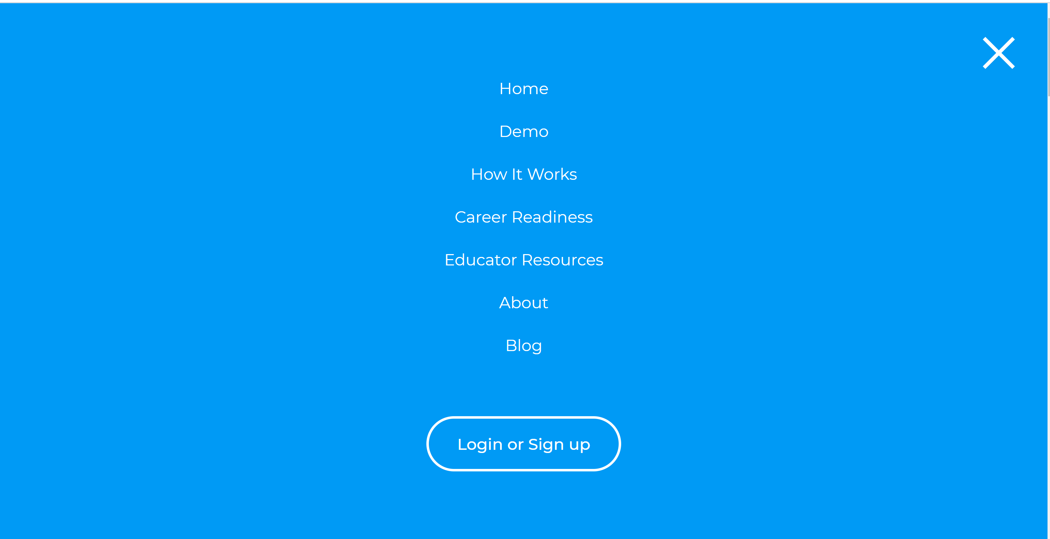

Slide 4
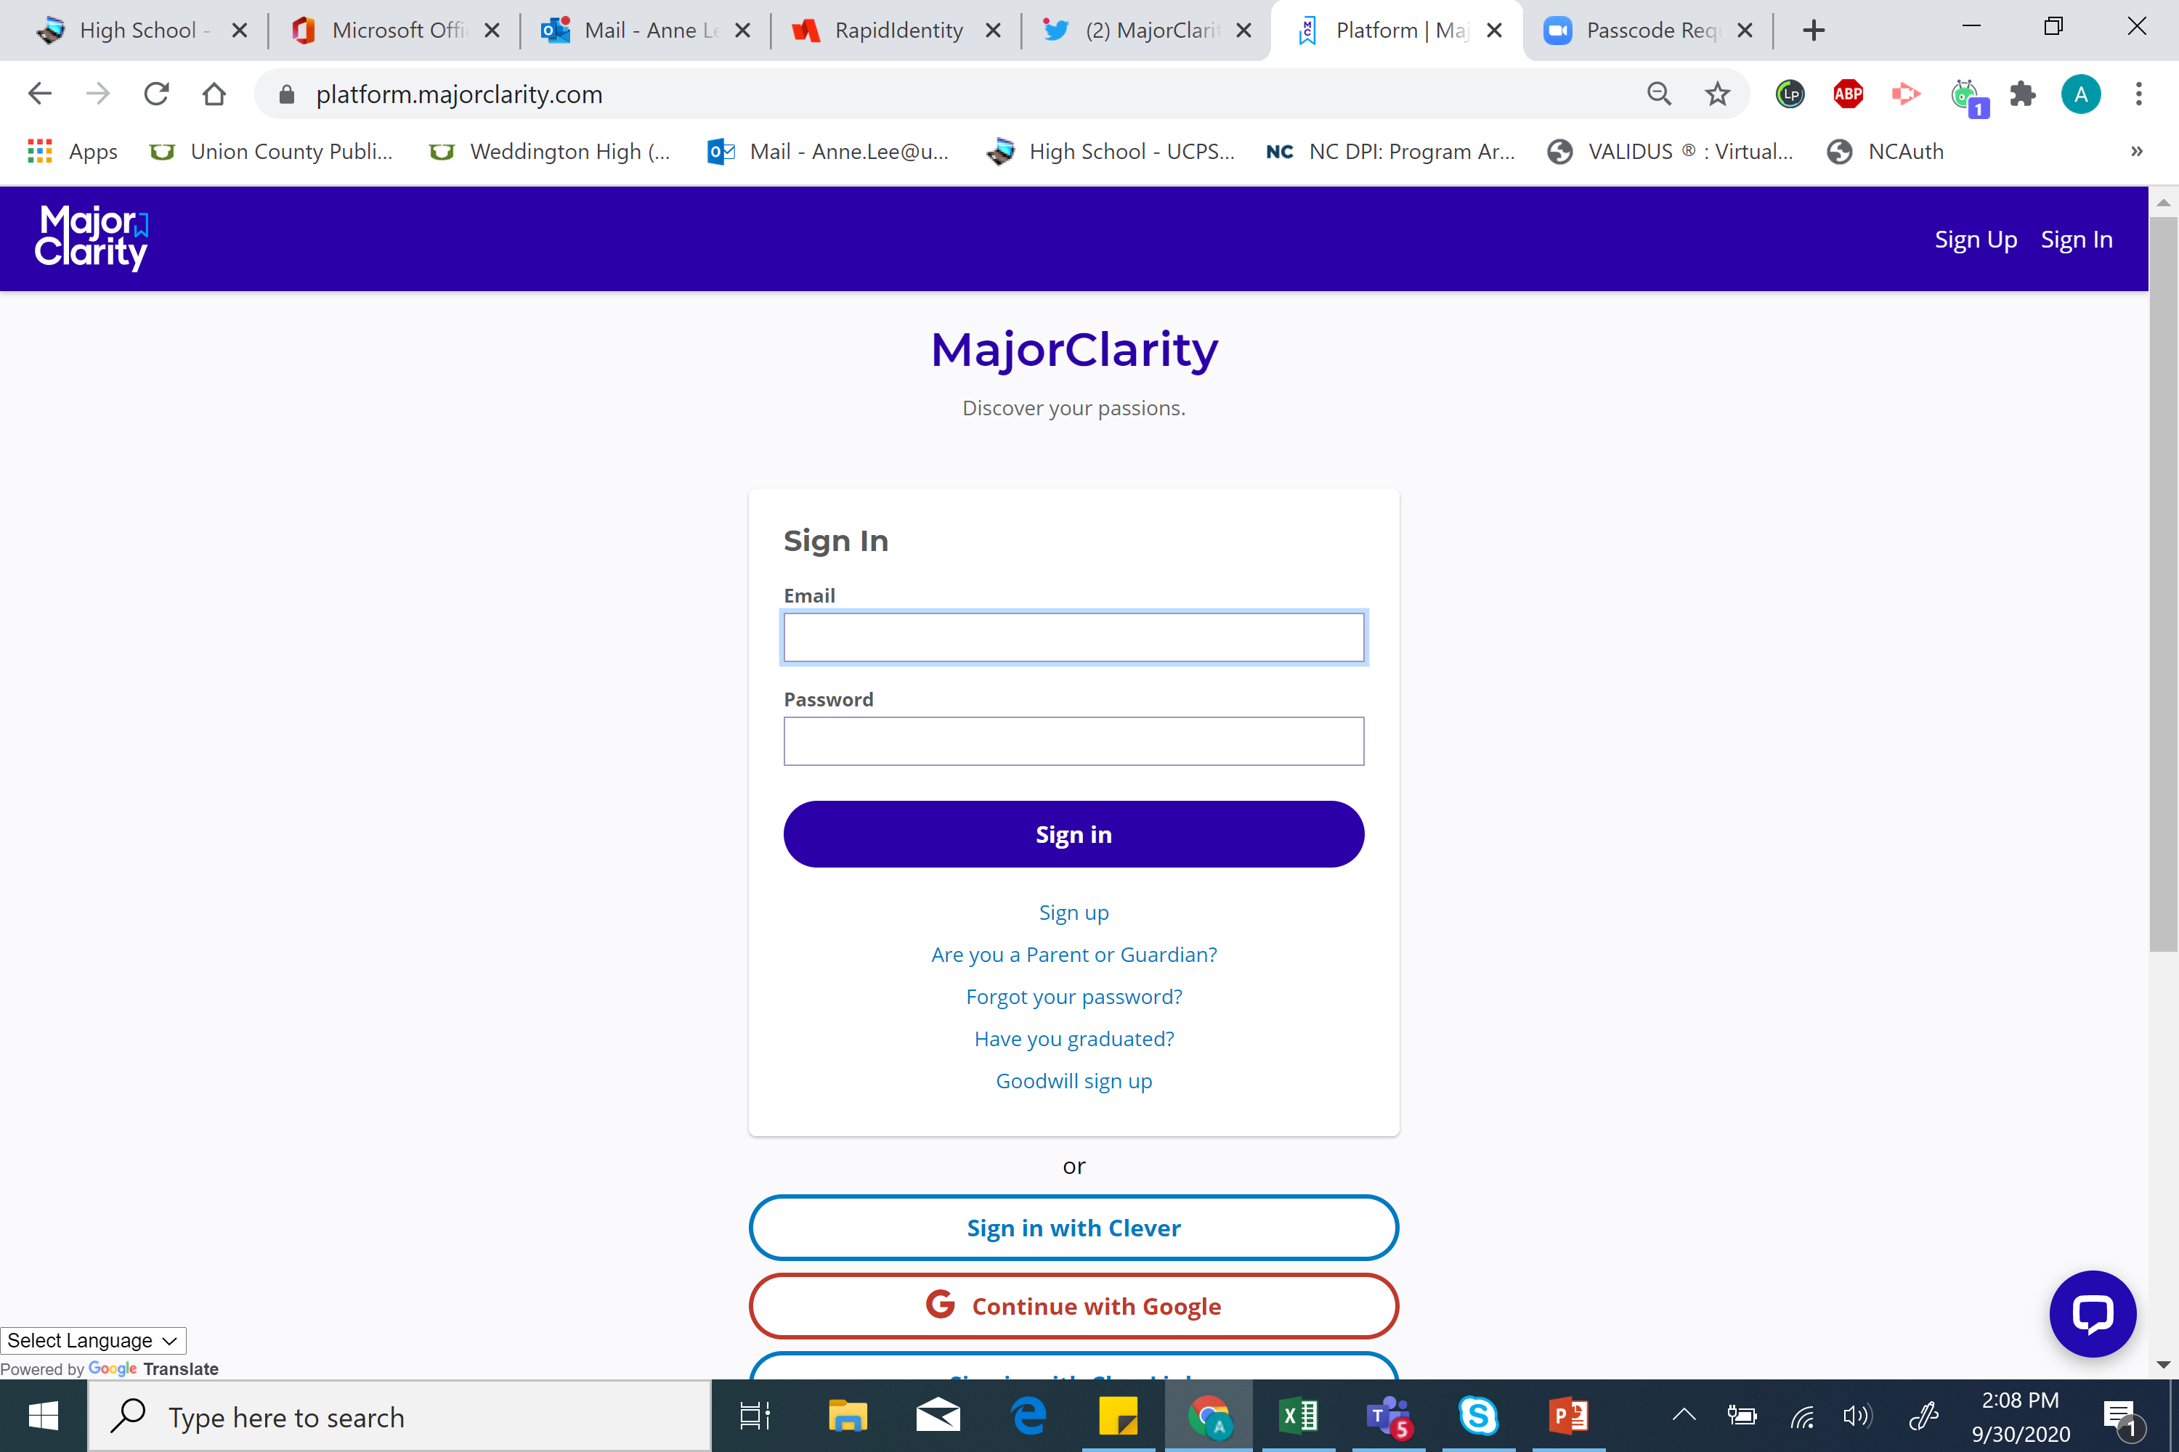
After signing in with Clever, you may come to a screen that asks you which school you attend

Slide 5
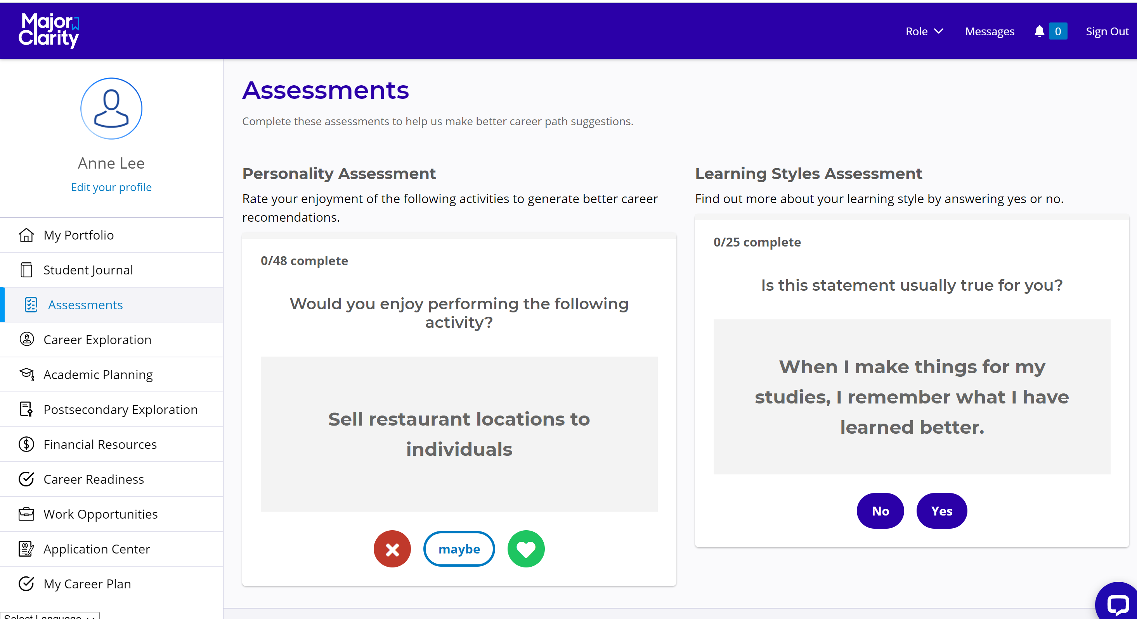
Click the icon which best reflects your opinion of each statement

Slide 6
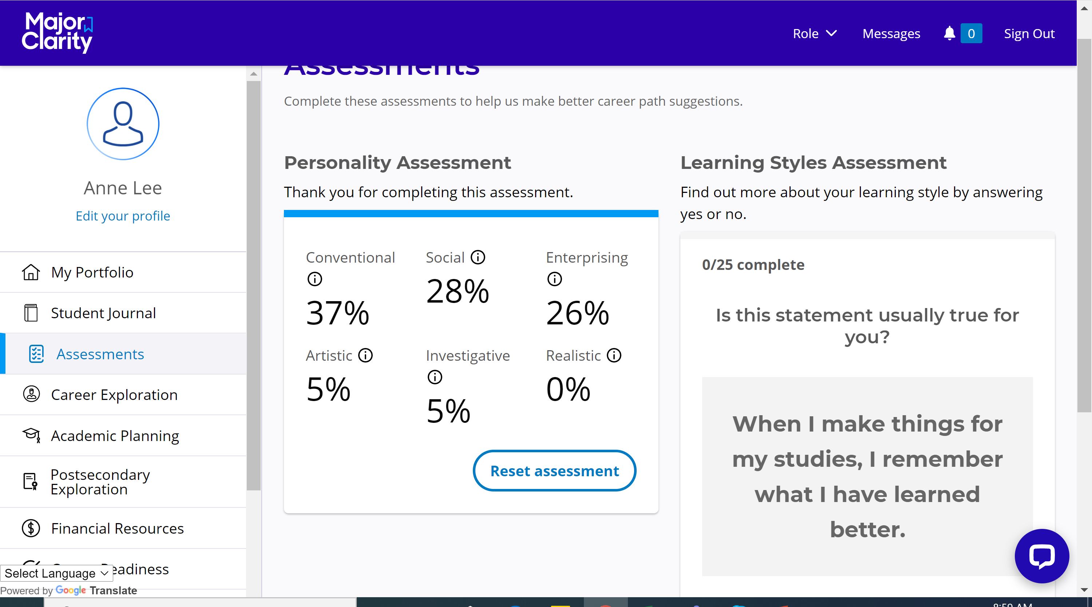
You can click on the icon beside each personality title to learn more.
OR
Watch the Holland Personality Types videos at https://tinyurl.com/y4k6yf7x

Slide 7
Take the personality assessment to help you make better career path decisions. Completing a self-assessment can help you choose a career or at least help you get an idea for which types of work best suit your personality.

Slide 8
Once you narrow it down to a group of potential career choices, you can more thoroughly research occupations before you make a decision about which to pursue.

Slide 9
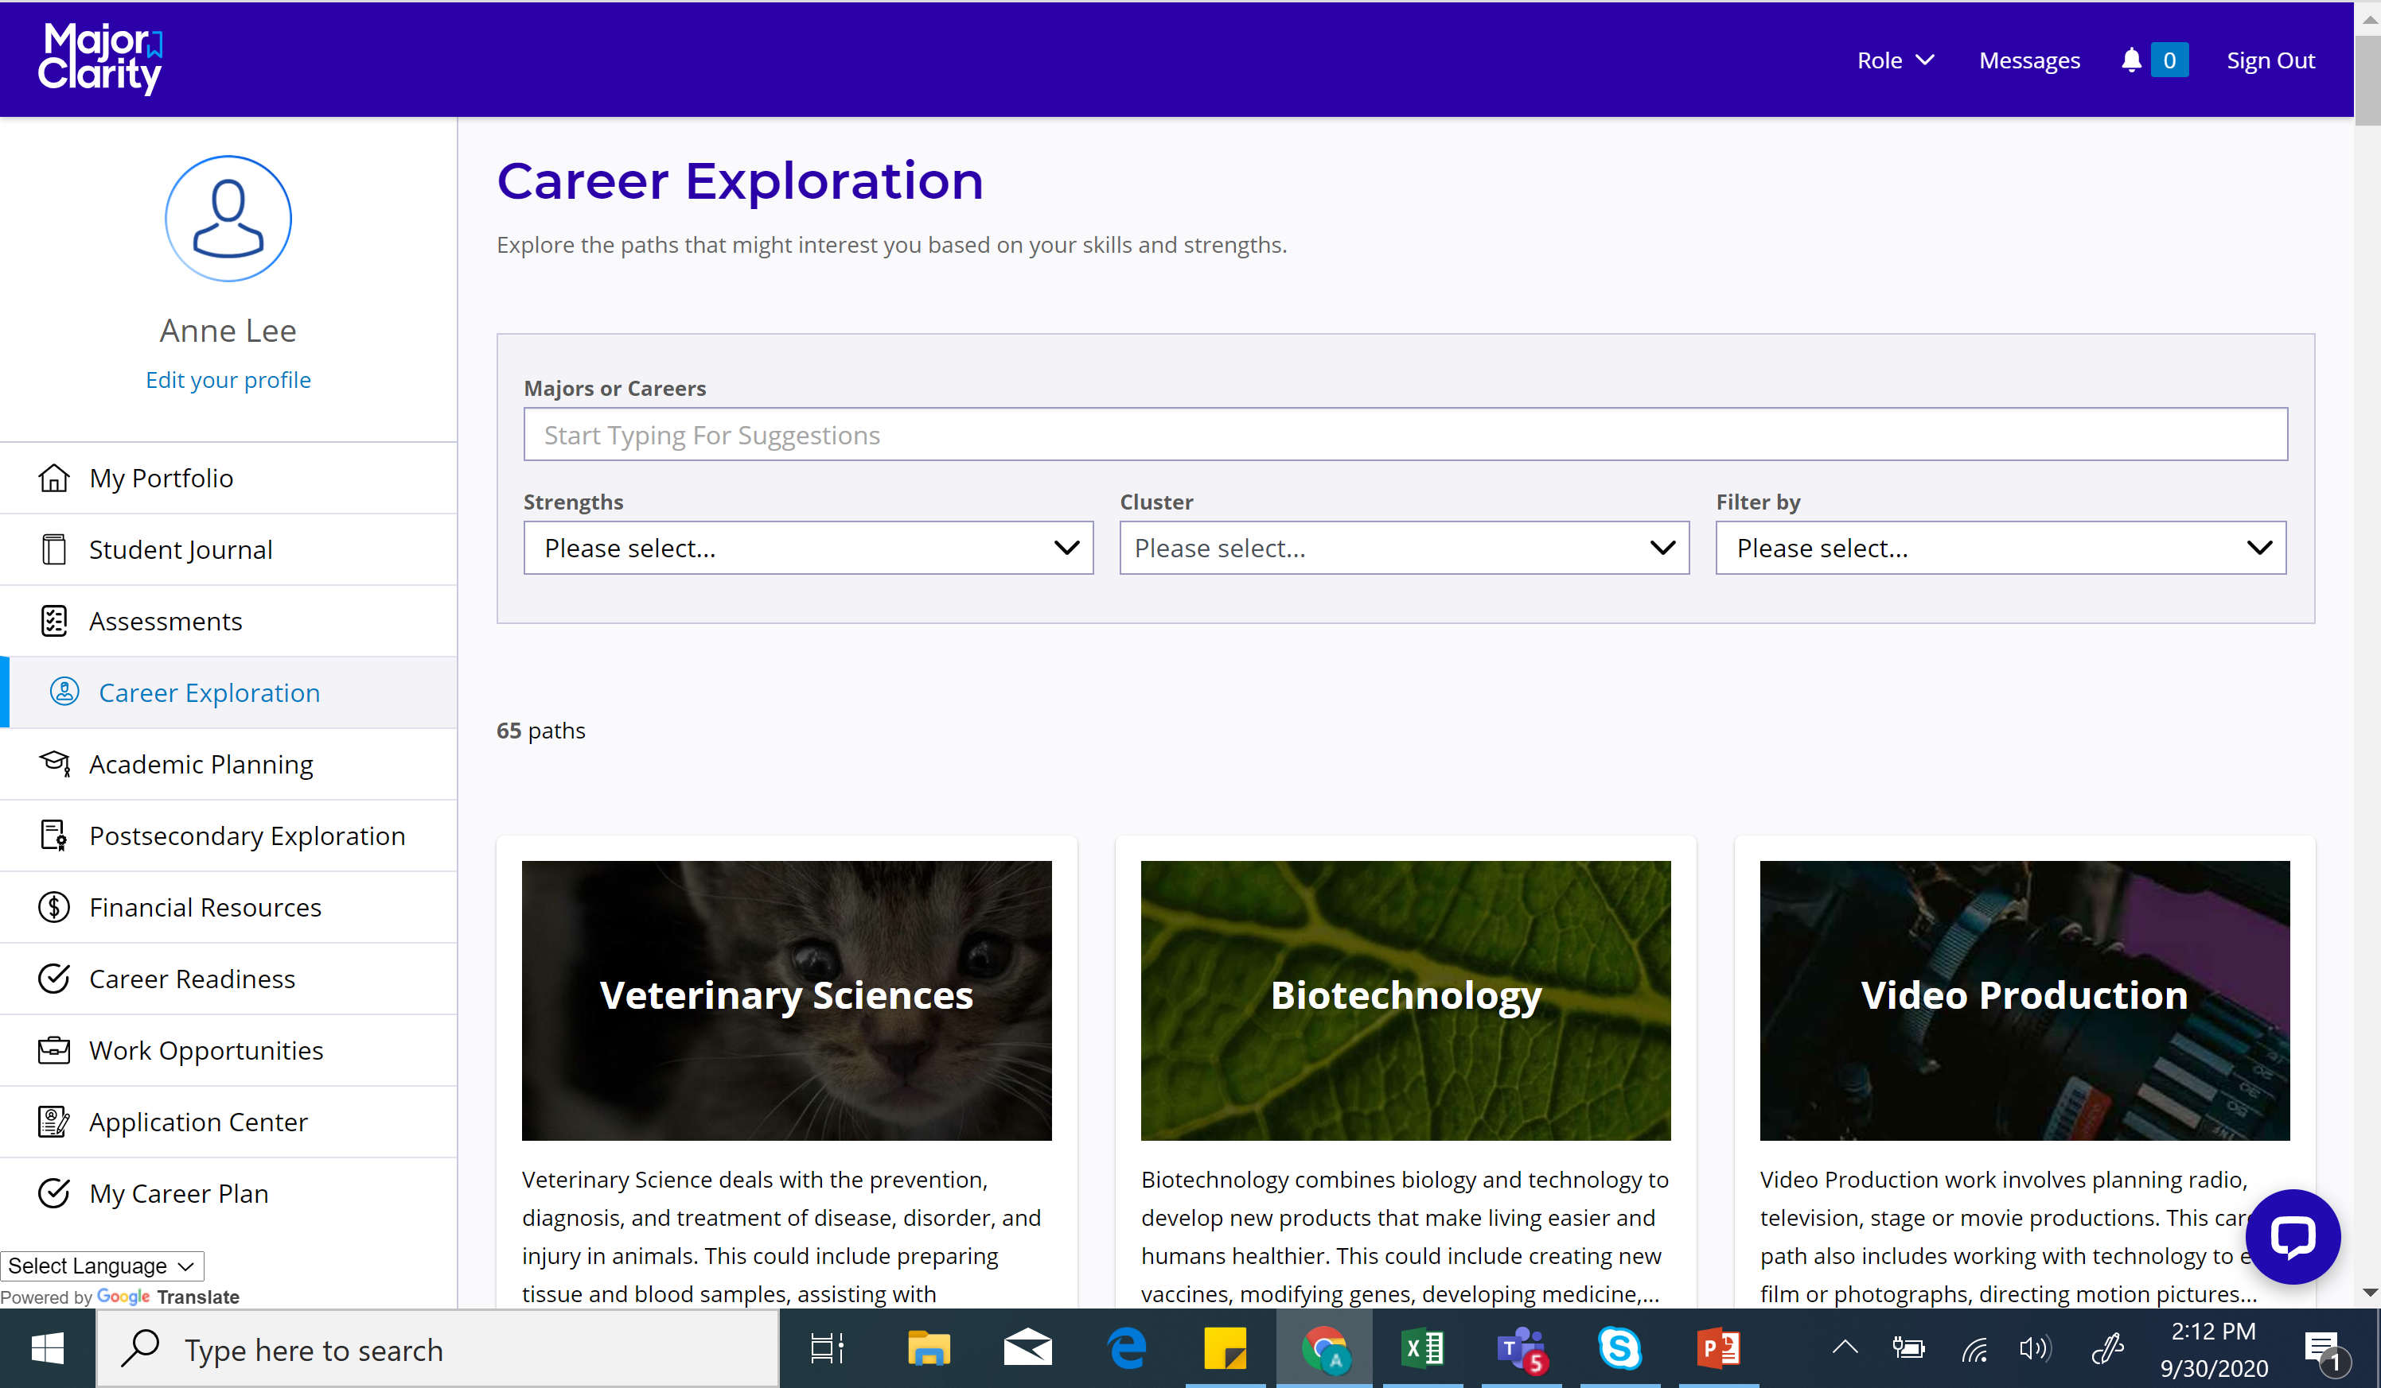

Slide 10
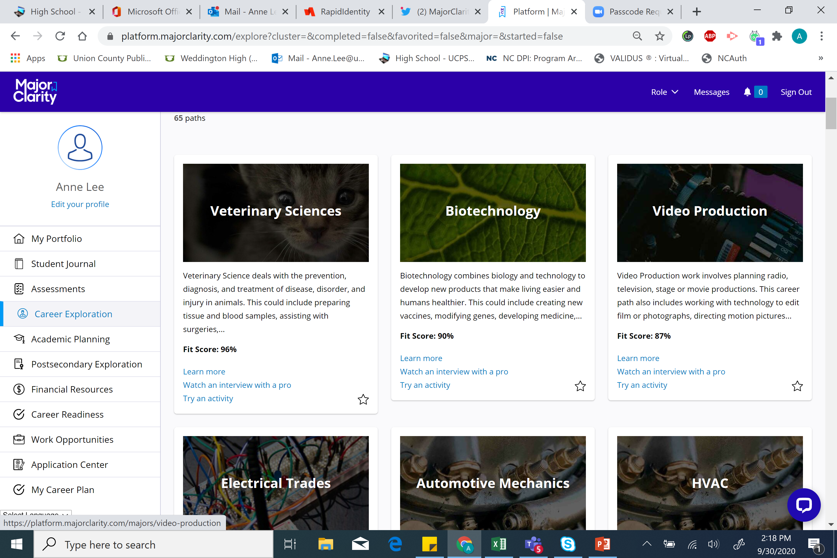

Slide 11
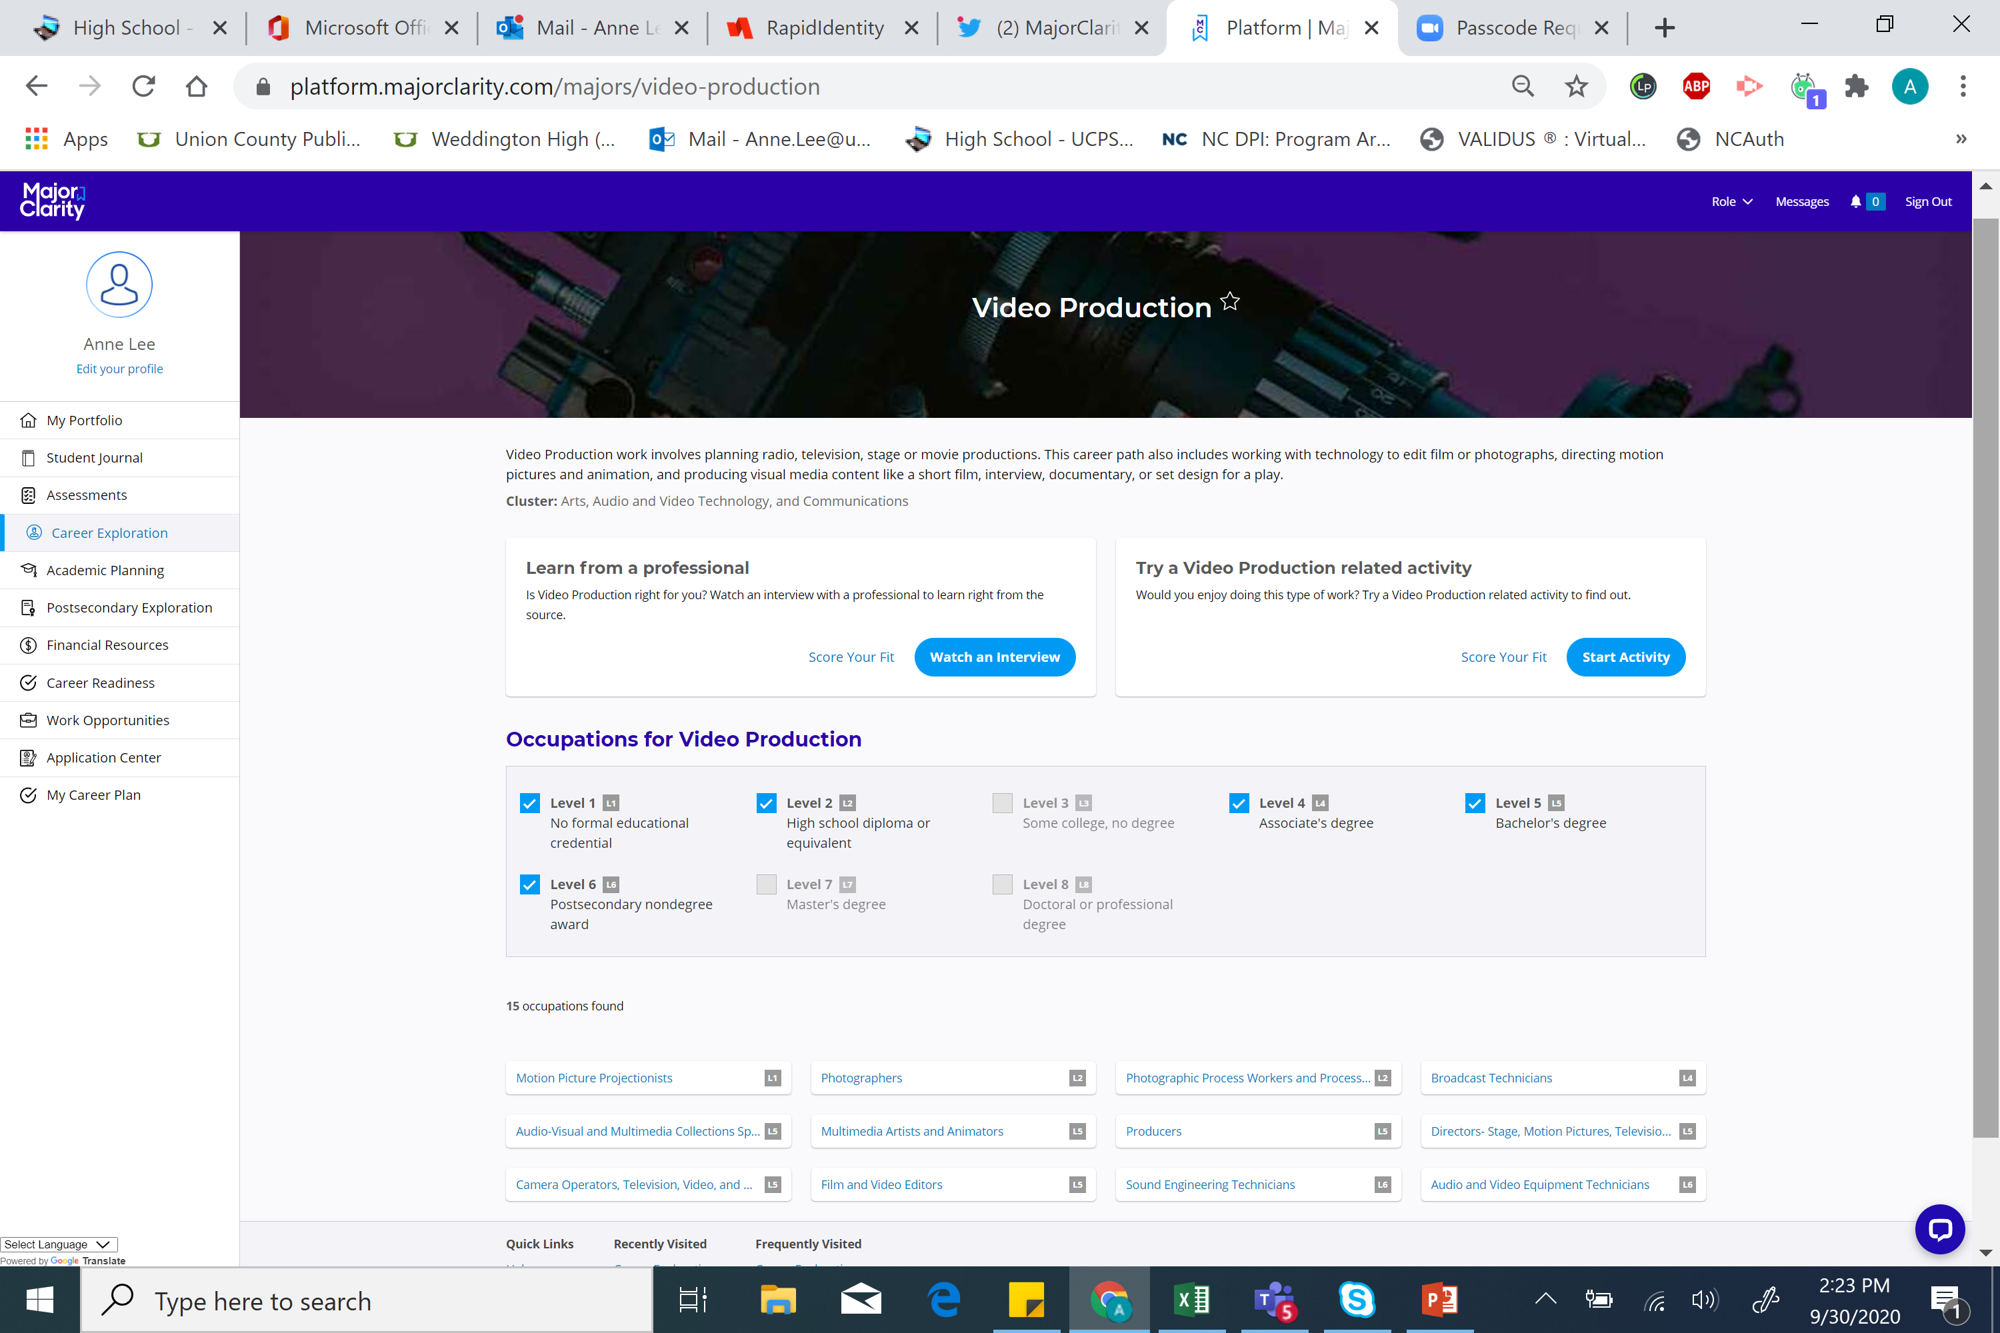

Slide 12
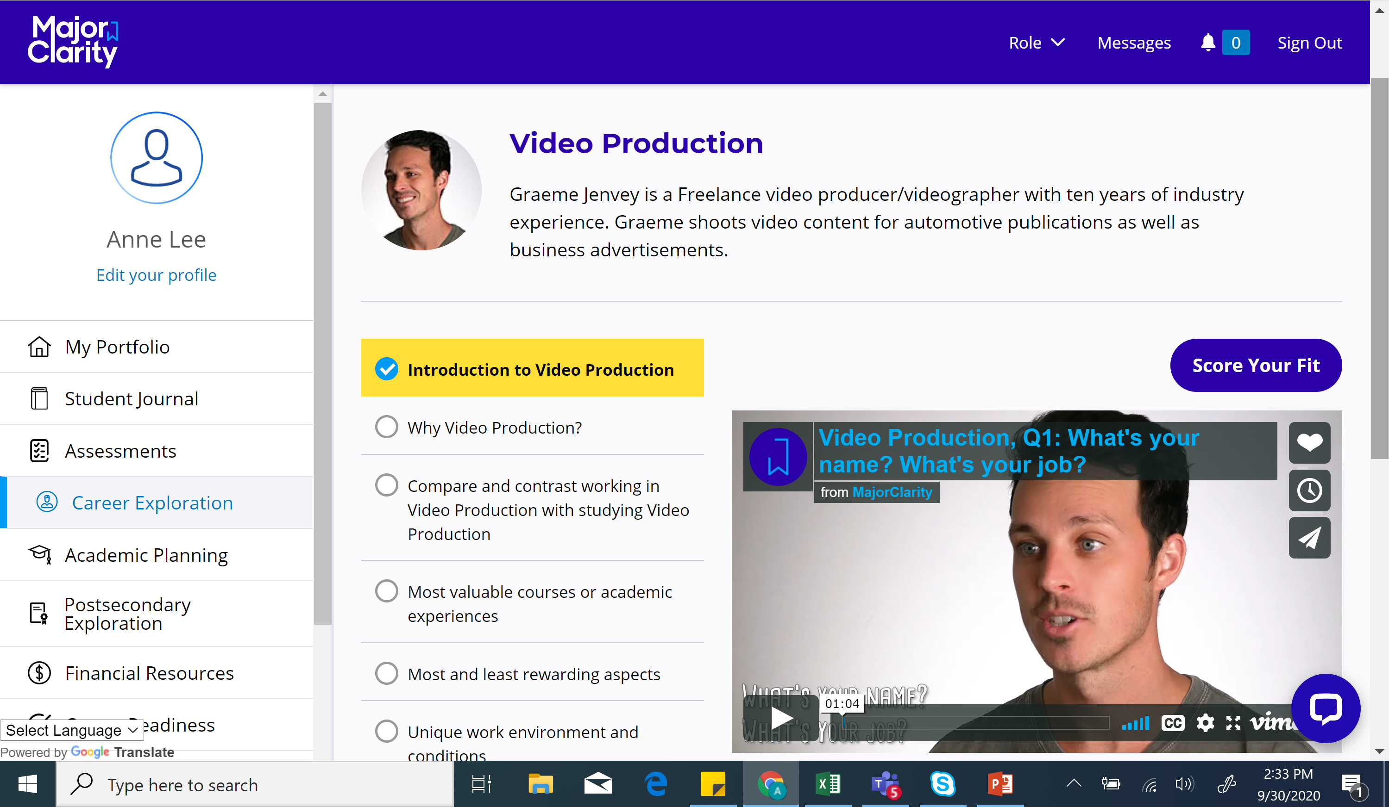

Slide 13
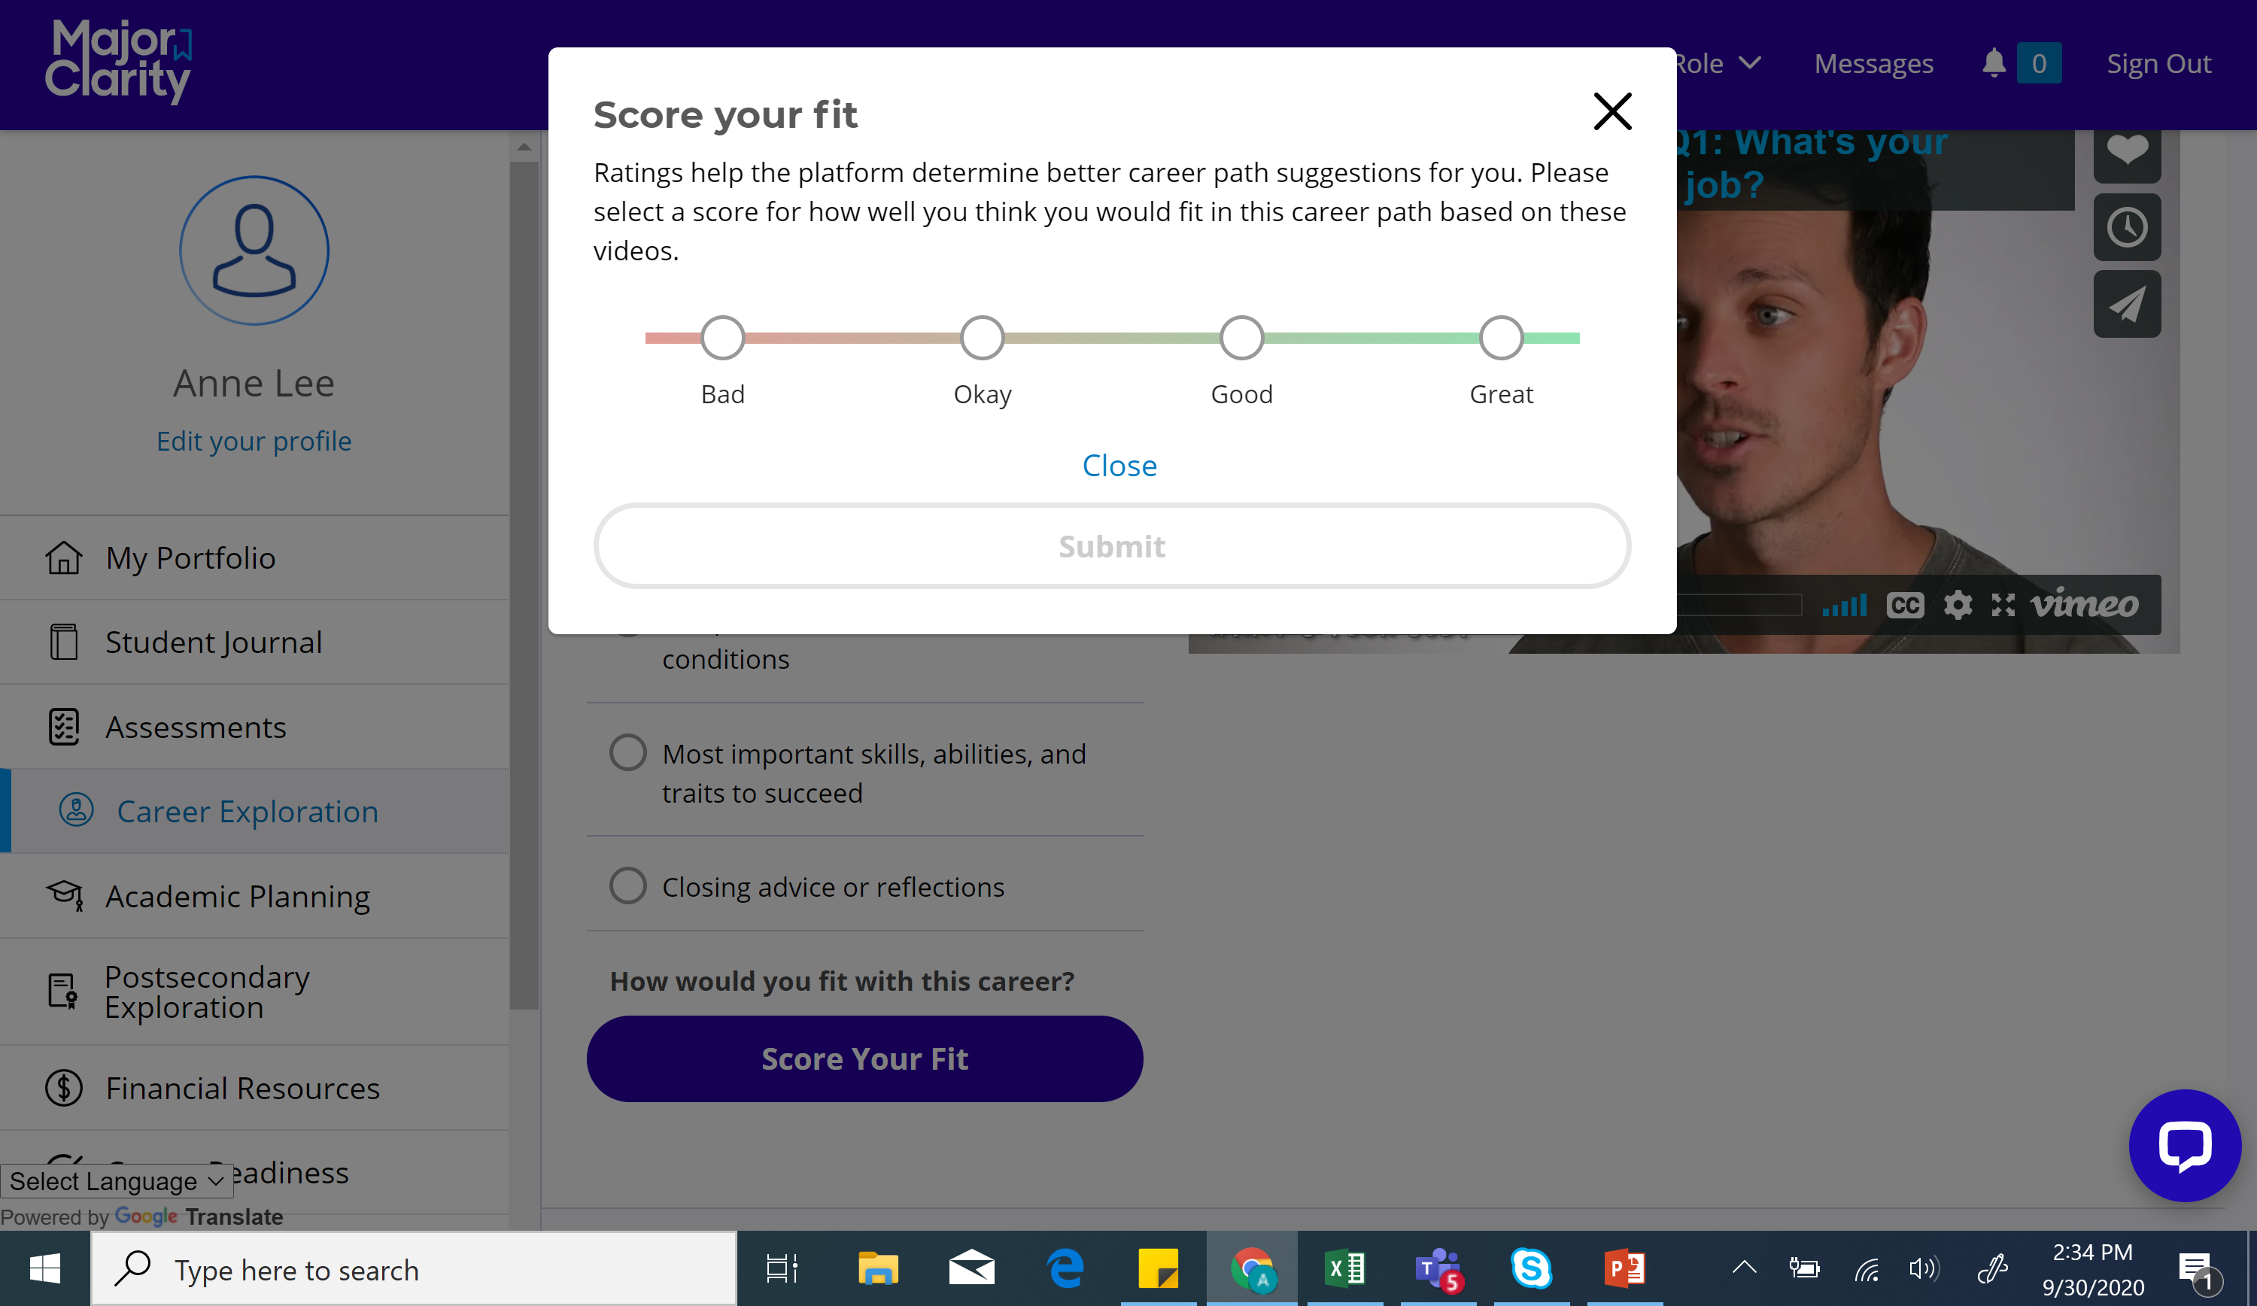

Slide 15
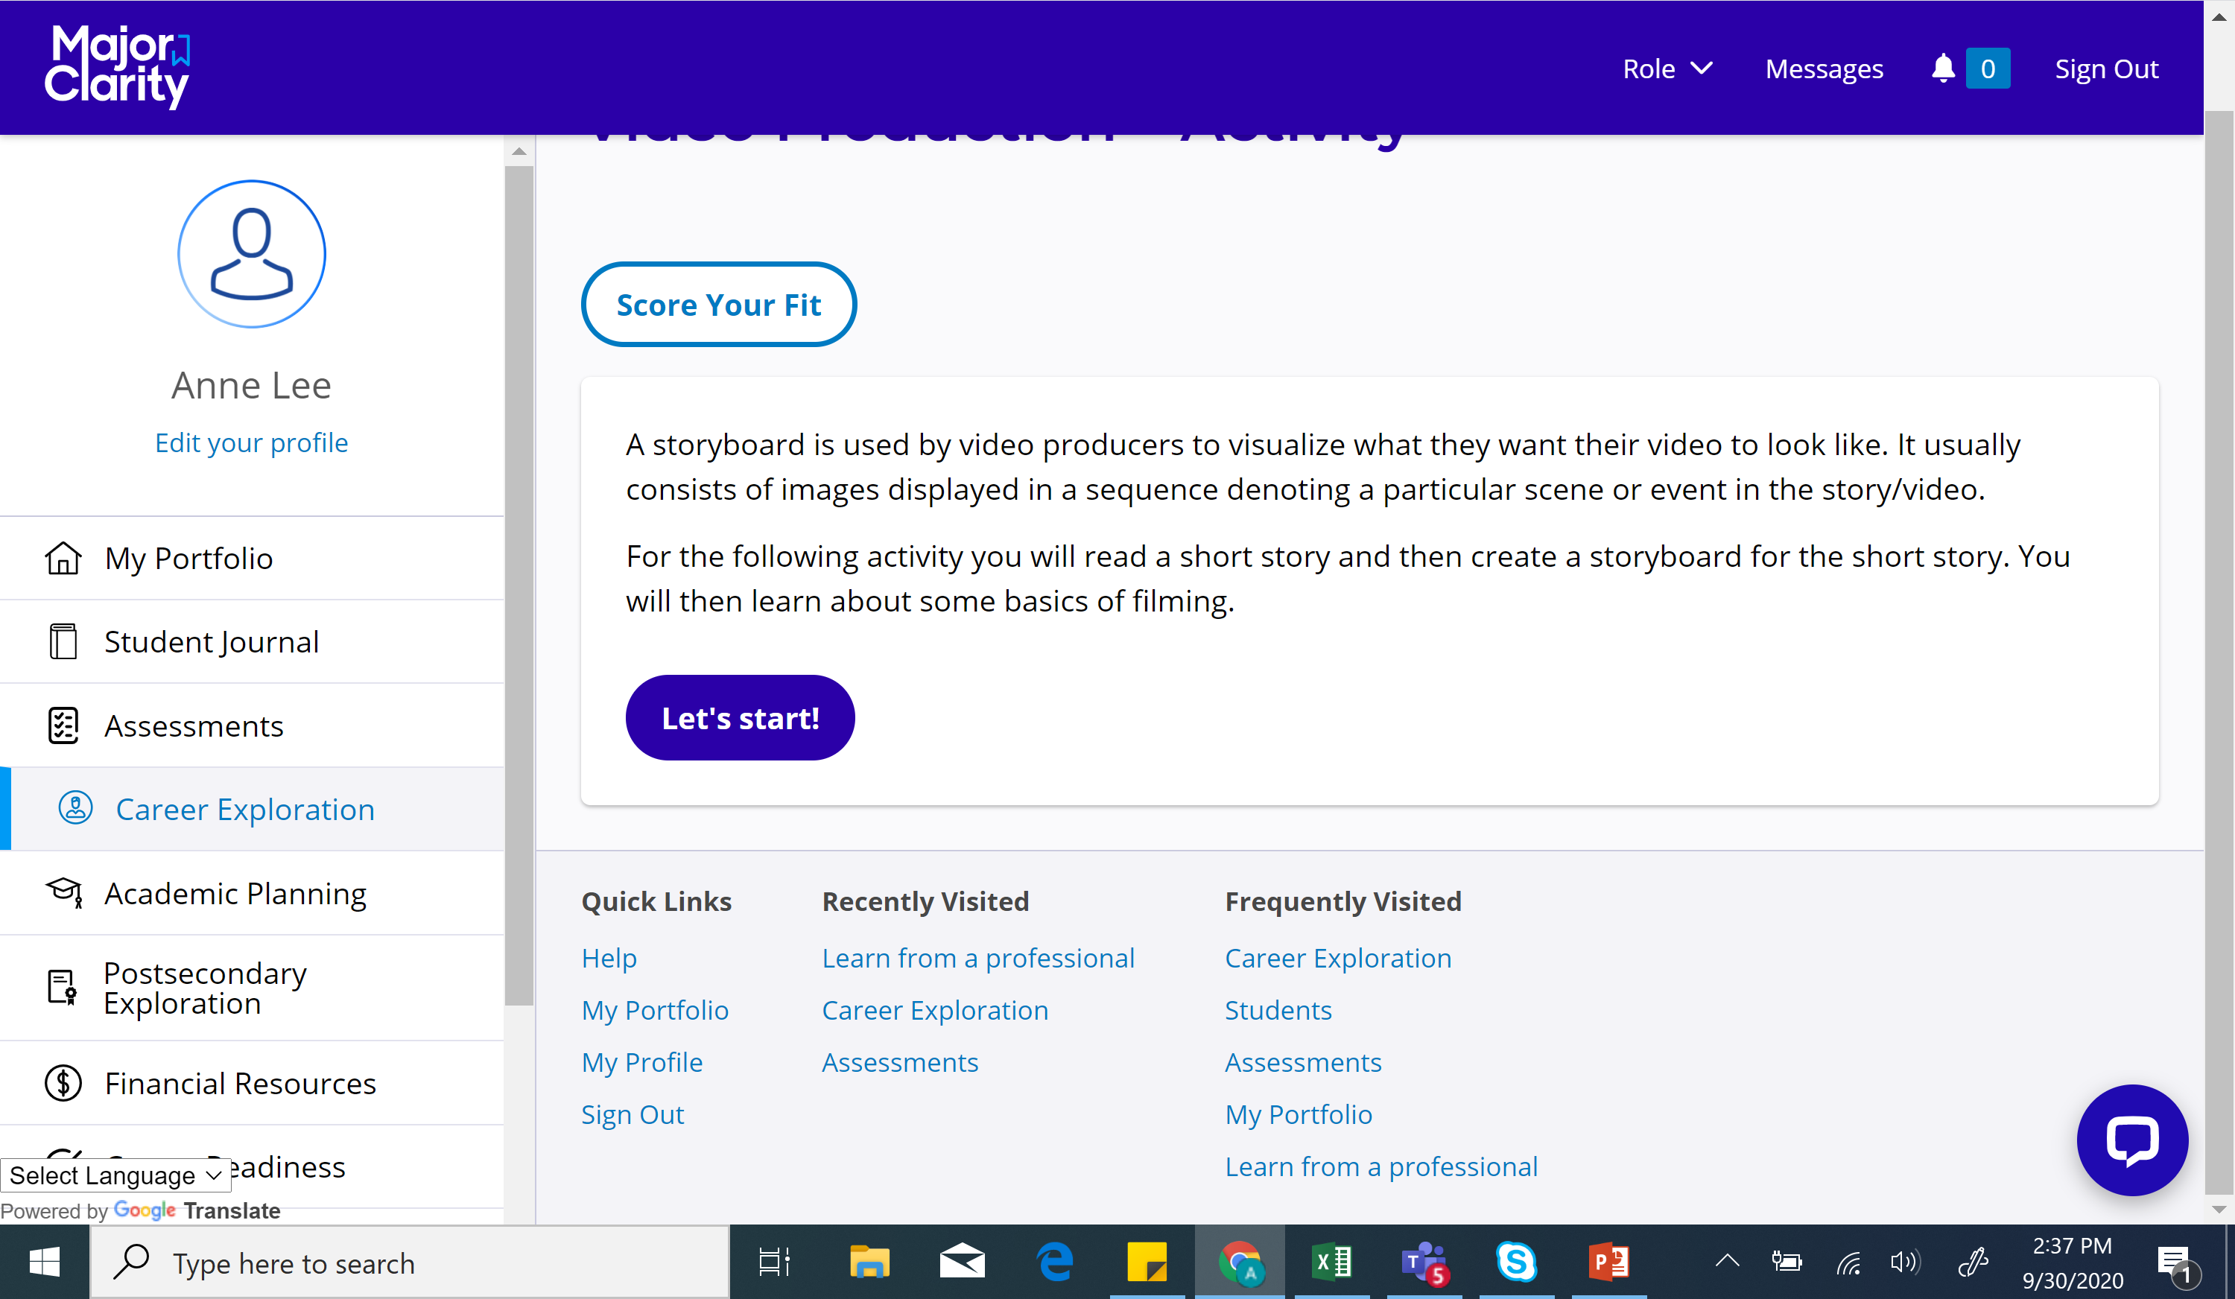

Slide 16
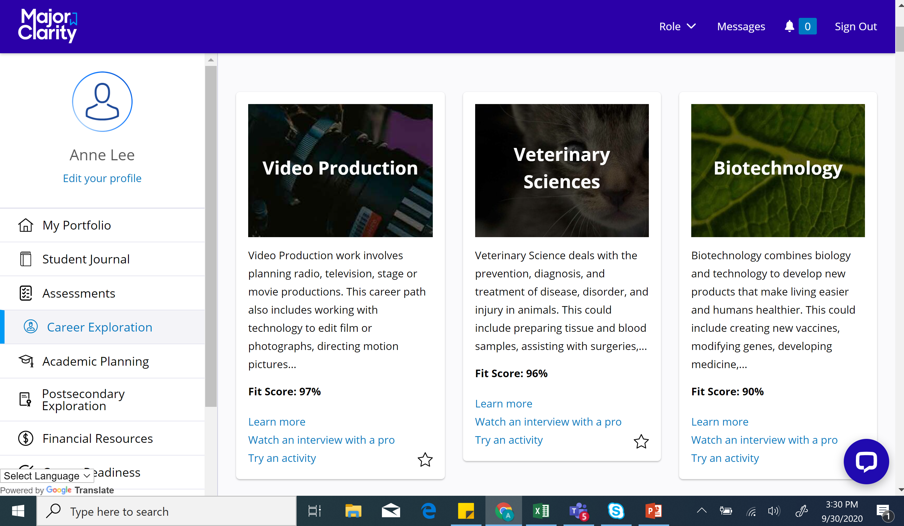

Slide 17
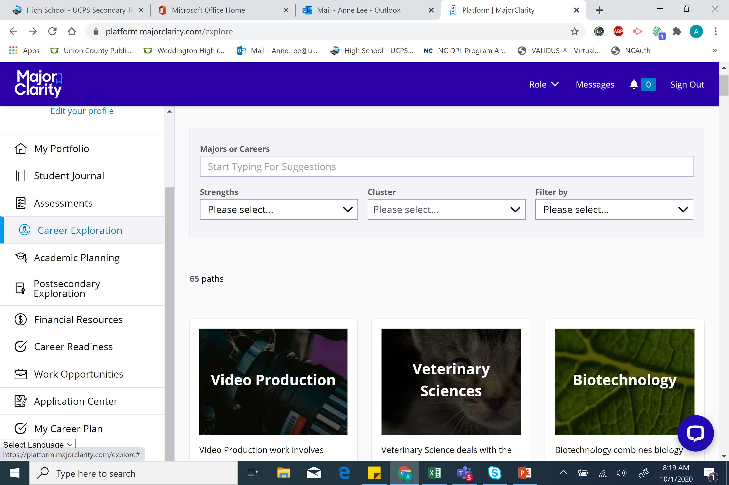

Slide 18
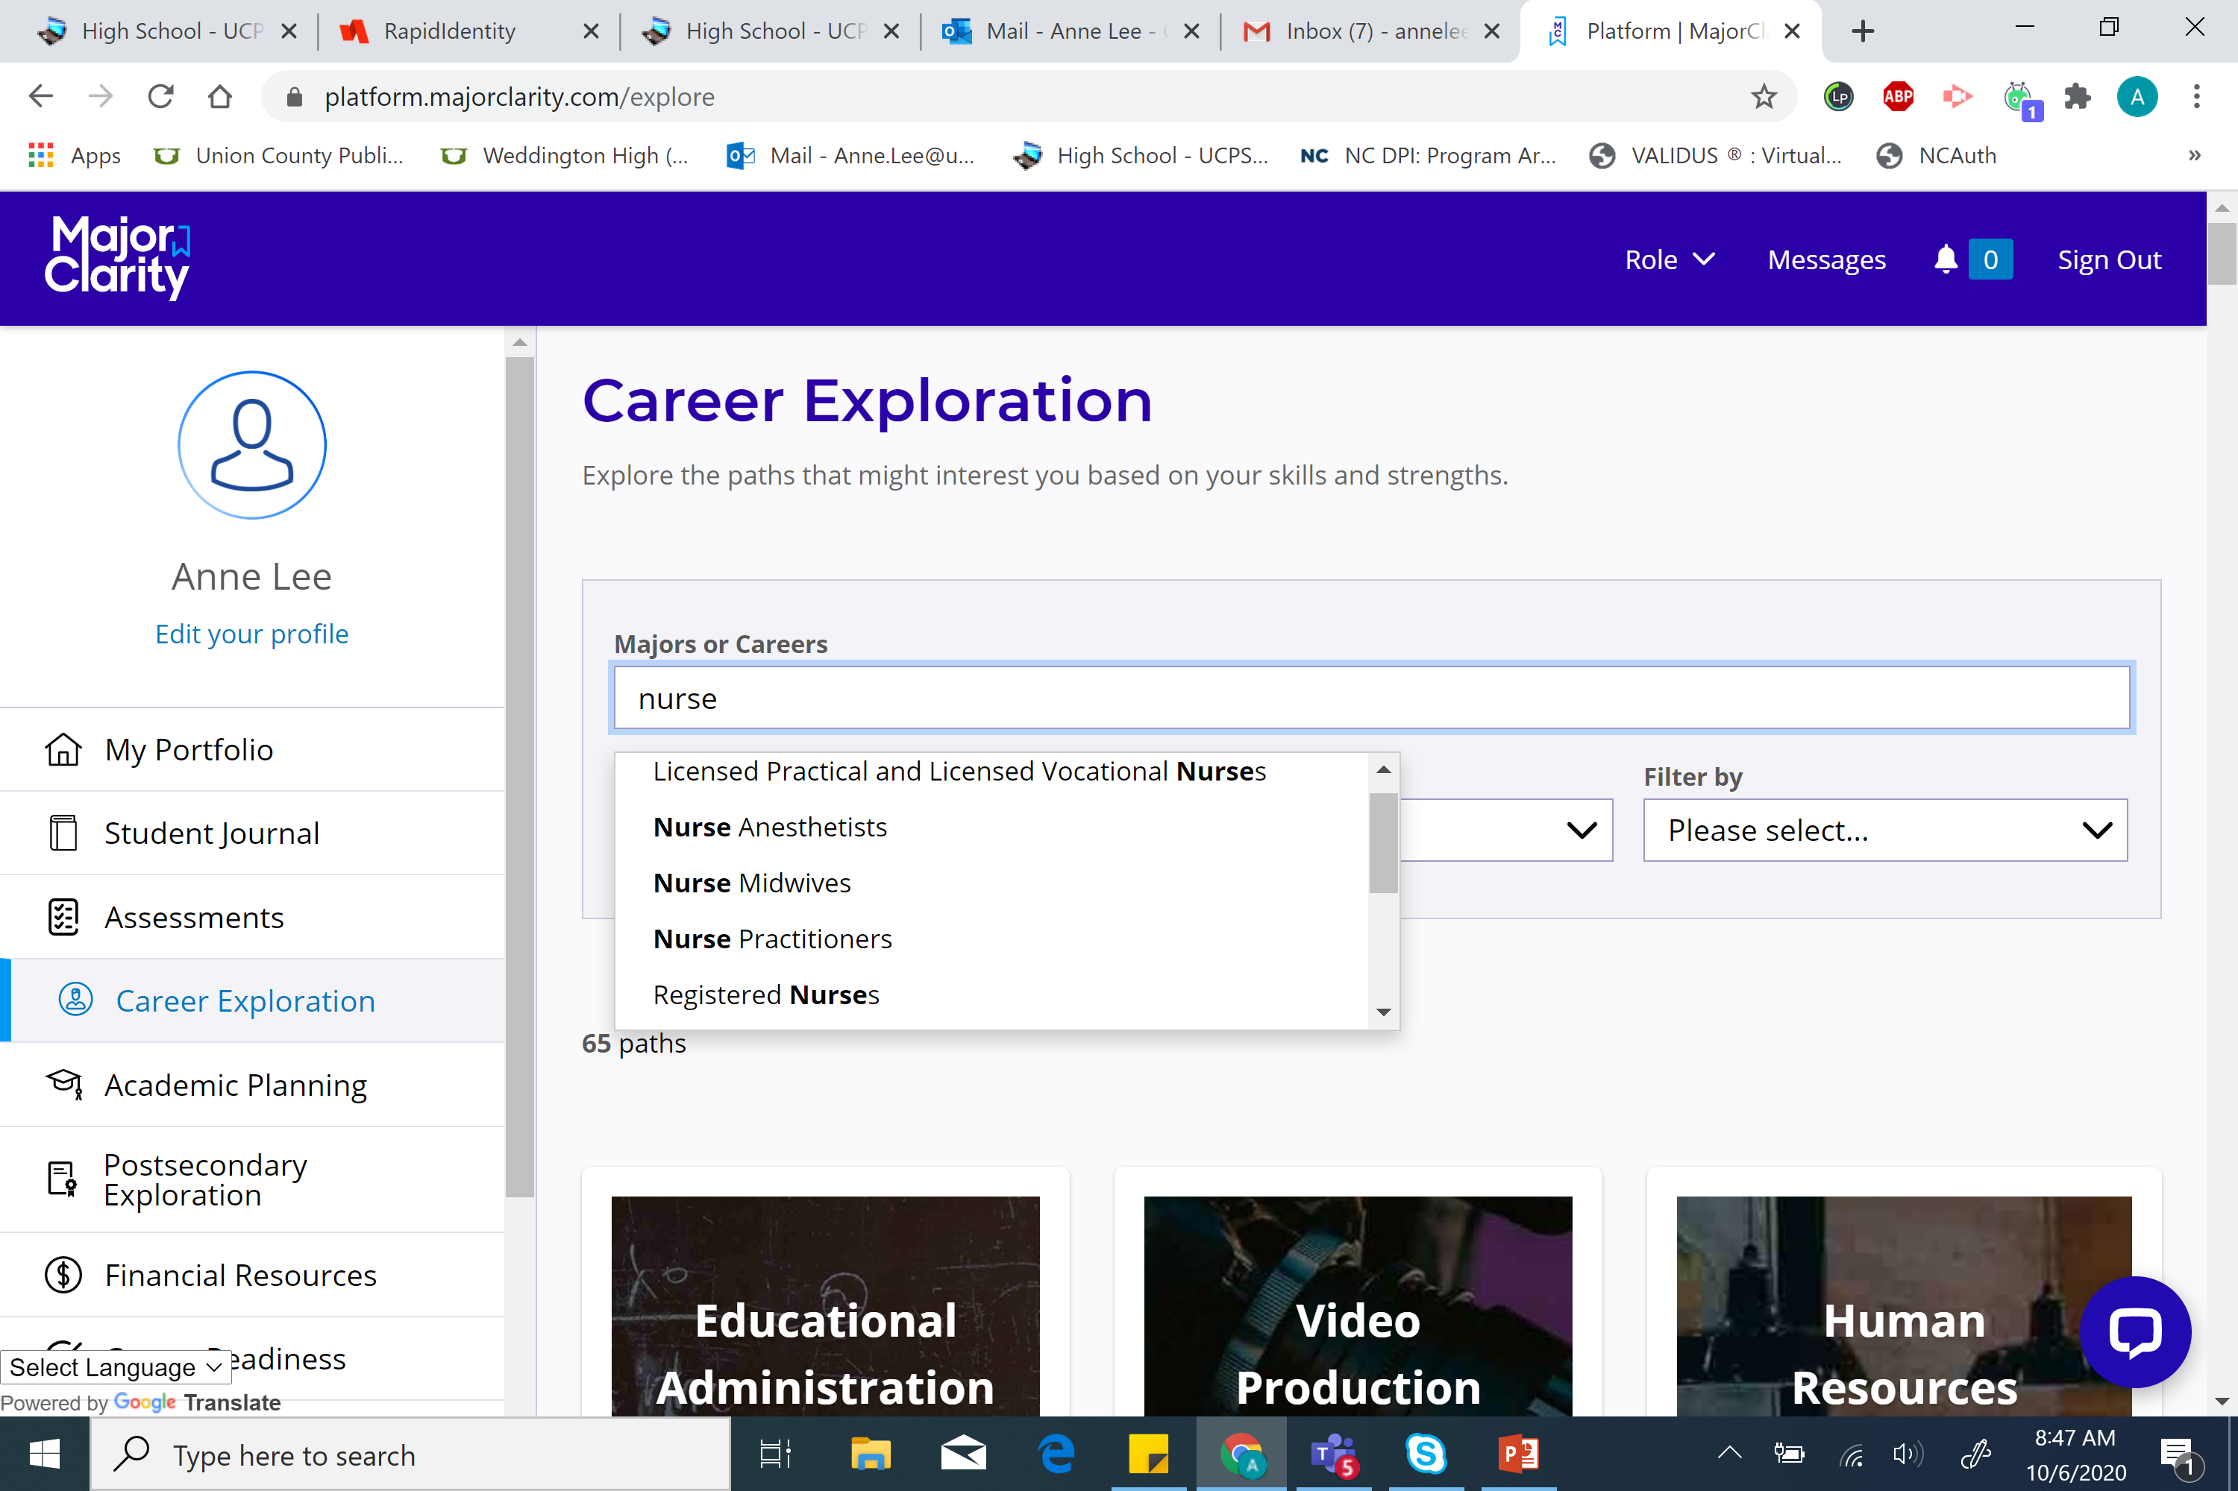

Slide 19
